Slide 1

DBS BANKING ANALYTICS
Loan, Customer & Transaction Intelligence
TEAM MEMBERS
Zeeshan Gausoddin Momin
Gowthu Surya Sai Uday Kalyan
Tejas Shivaji Wagh
Arunprasad Rajesh Kounder
Naman Raikwar
Created By –Zeeshan Momin
Final Project Submission

Slide 2
Index
1
Project Overview
6
Dashboard Screenshots
2
Problem Statement
7
SQL Queries
3
Tools Used
8
Key Findings / Observations
4
Dataset Information
9
Challenges & Solutions
5
KPIs (Loan + Debit/Credit)
10
Conclusion
DBS Banking Analytics
2

Slide 3




Project Overview
End-to-end banking analytics built across four platforms
This project analyzes banking loan performance, customer activity, and debit-credit transactions.
Excel
SQL
Tableau
Power BI
24 KPIs + 2 dashboards
Database creation + KPI queries
Loan & Customer dashboard
Debit & Credit dashboard using SQL data
DBS Banking Analytics
3

Slide 4






Problem Statement
Banks require a unified analytics system to track:
Loan disbursement trends
Customer activity
Credit vs Debit behavior
Branch performance
High-risk & suspicious transactions
Product-wise loan distribution
DBS Banking Analytics
4

Slide 5
Tools Used
Excel
KPI creation + dashboards
MySQL
Database creation + SQL KPI queries
Power BI
Debit/Credit dashboard
Tableau
Loan dashboard
Note: No Power Query used
DBS Banking Analytics
5

Slide 6
Dataset Information
TABLES
COLUMNS
TOTAL RECORDS
Loan data
Customer details
2000+
Repayment data
Loan details
Transaction data
Transaction details
Branch
Bank
Method
DBS Banking Analytics
6

Slide 7
KPIs — Loan Analysis
12 KPIs
Total Clients
Active Clients
New Clients
1
2
3
Total Loan Amount Disbursed
Total Funded Amount
Average Loan Size
4
5
6
Loan Growth %
Total Repayments Collected
Principal Recovery Rate
7
8
9
Interest Income
Loan Distribution by Branch
Product-wise Loan Volume
10
11
12
DBS Banking Analytics
7

Slide 8
KPIs — Debit & Credit Analysis
12 KPIs
Total Credit Amount
Total Debit Amount
Credit to Debit Ratio
1
2
3
Net Transaction Amount
Account Activity Ratio
Transactions per Day/Week/Month
4
5
6
Total Transaction Amount by Branch
Transaction Volume by Bank
Transaction Method Distribution
7
8
9
Branch Transaction Growth
High-Risk Transaction Flag
Suspicious Transaction Frequency
10
11
12
DBS Banking Analytics
8

Slide 9
Workflow Summary
1
Step 1
Created all 24 KPIs using Excel
2
Step 2
Built 2 Excel dashboards Using Pivot (Loan KPIs + Debit/Credit KPIs)
3
Step 3
Wrote SQL queries for all KPIs
4
Step 4
Loaded data into Tableau → Built Loan Dashboard
5
Step 5
Loaded SQL data into Power BI → Built Debit & Credit Dashboard
DBS Banking Analytics
9

Slide 10
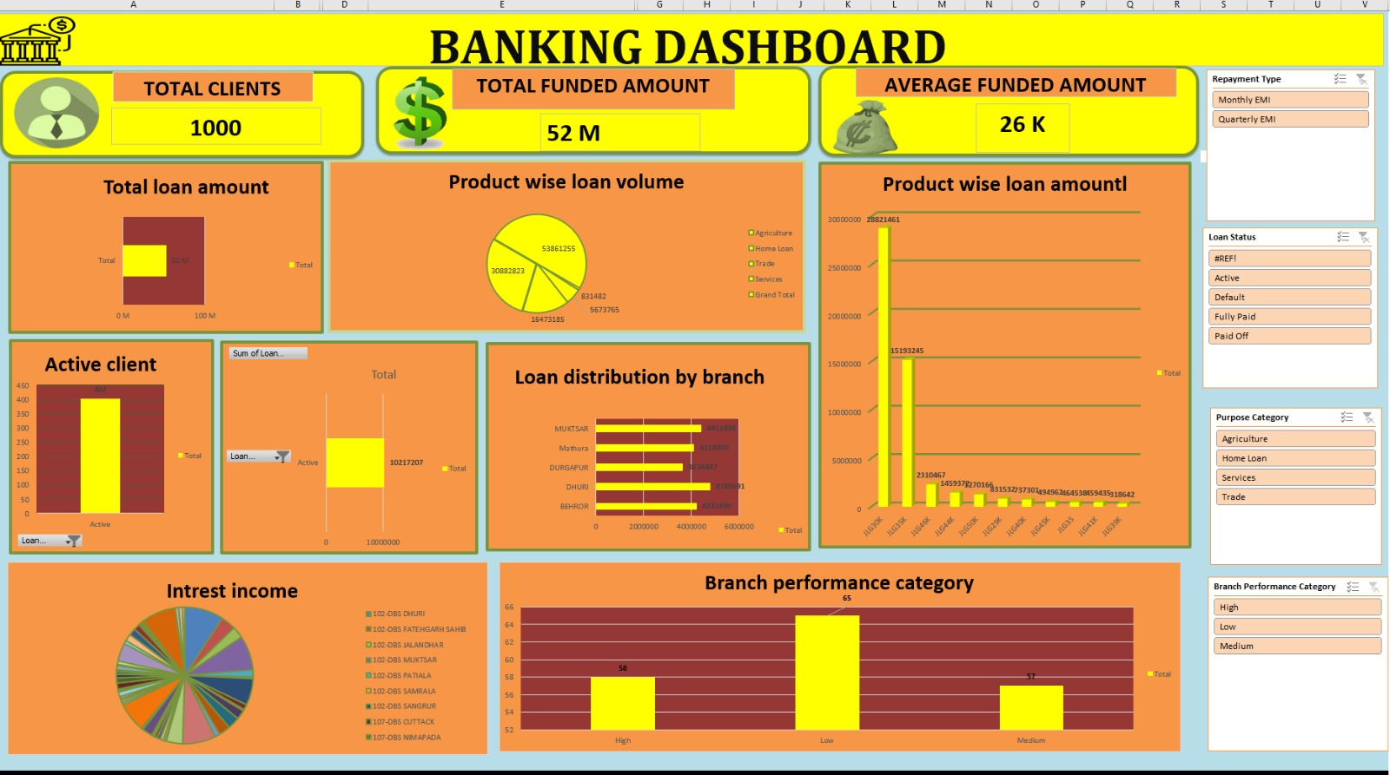
Excel Dashboard (Loan KPIs)
DBS Banking Analytics
10

Slide 11
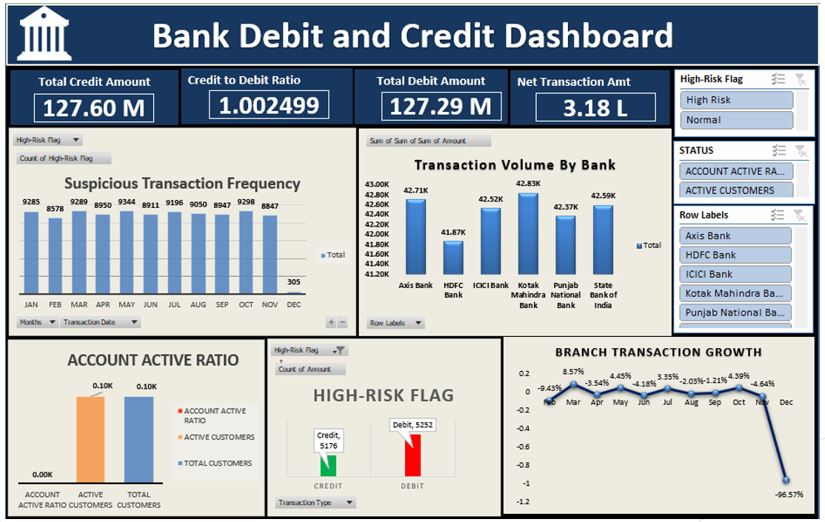
Excel Dashboard (Debit/Credit KPIs)
Insert screenshot here
DBS Banking Analytics
11

Slide 12
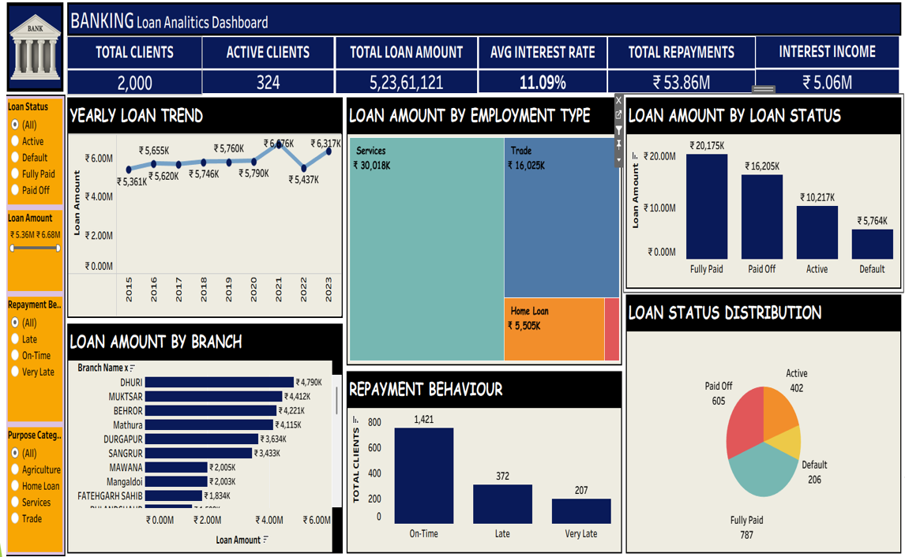
Tableau Dashboard
Insert screenshot here
DBS Banking Analytics
12

Slide 13
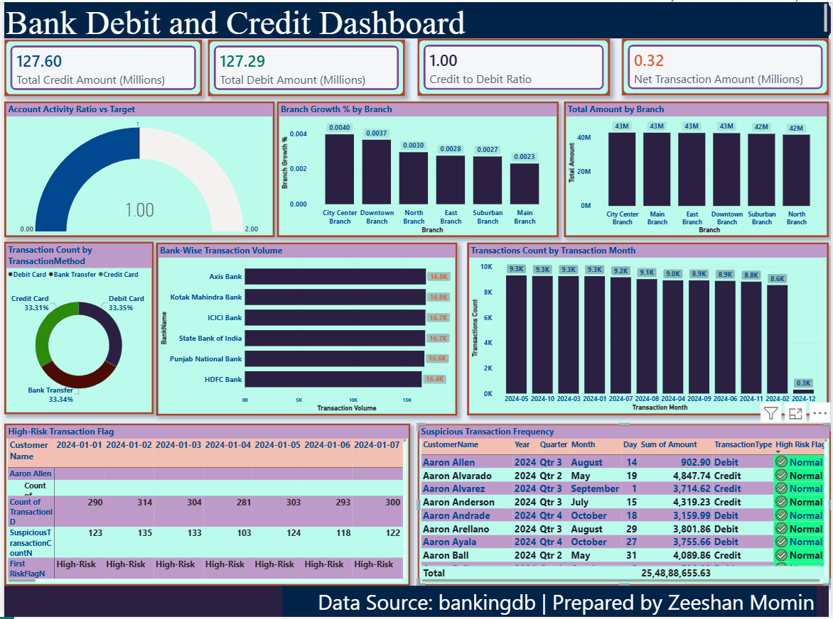
Power BI Dashboard
Insert screenshot here
DBS Banking Analytics
13

Slide 14
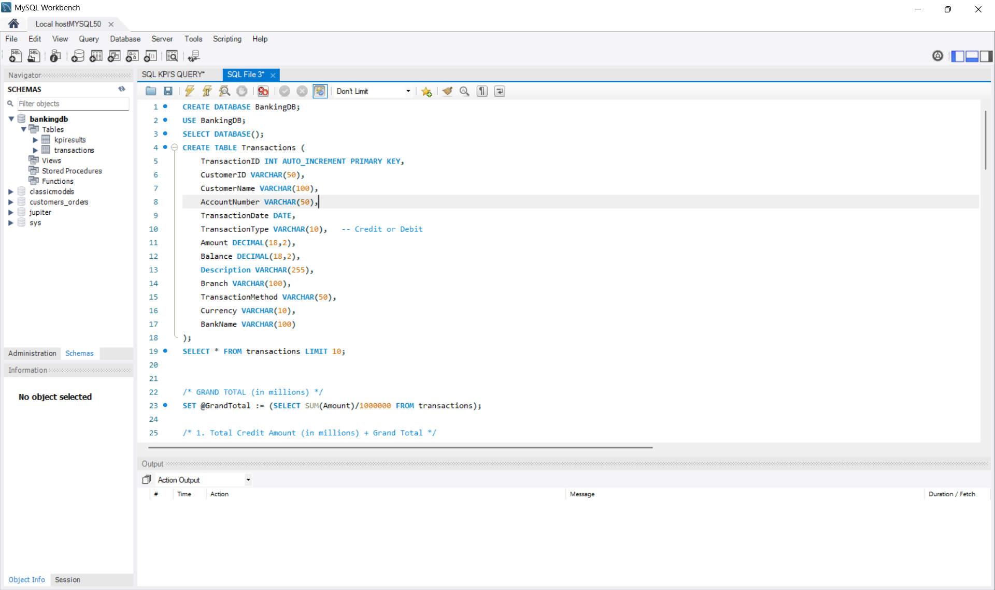
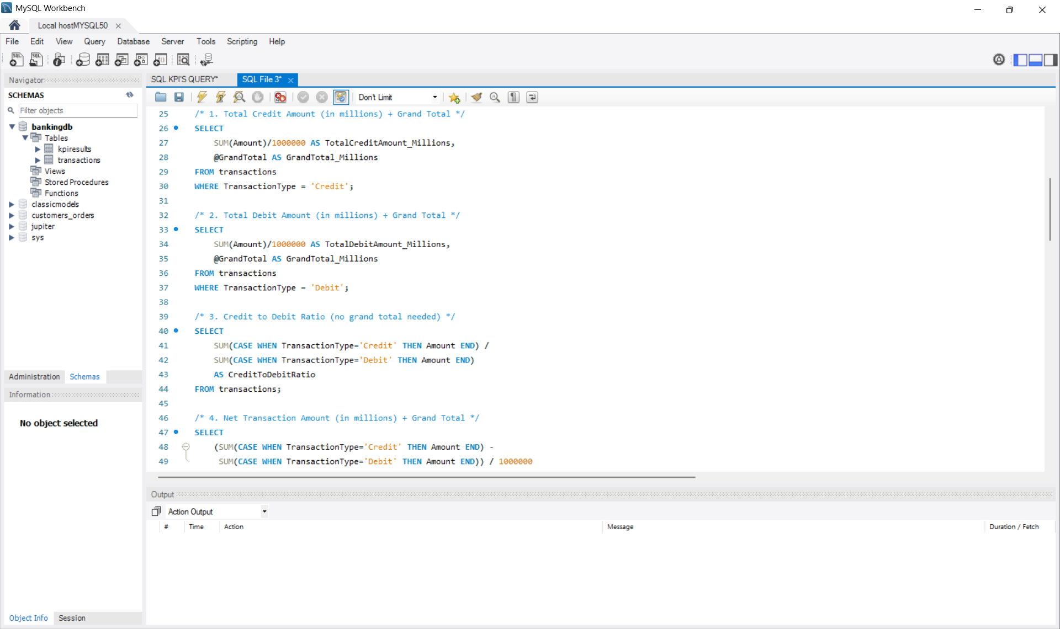
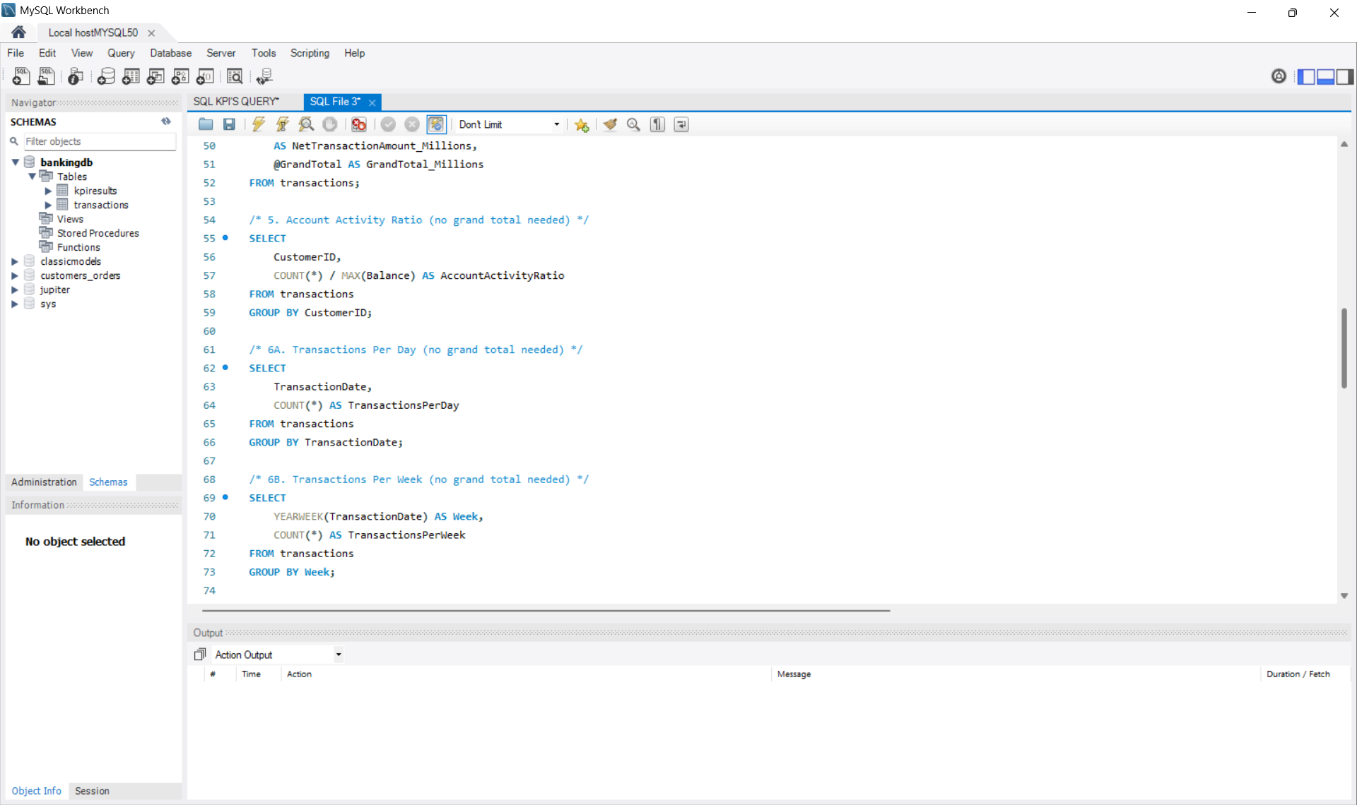
SQL Queries
SQL Queries
DBS Banking Analytics
14

Slide 15
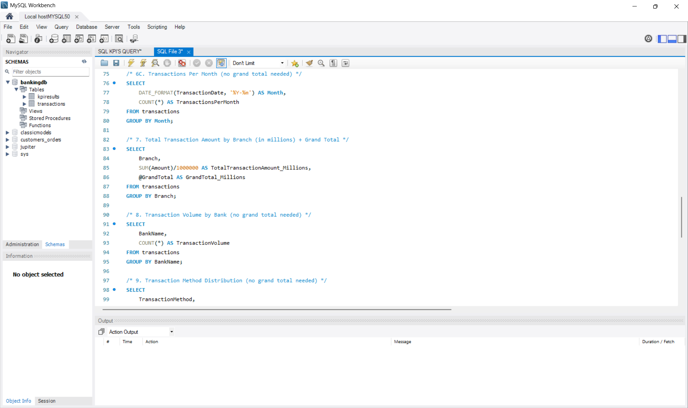
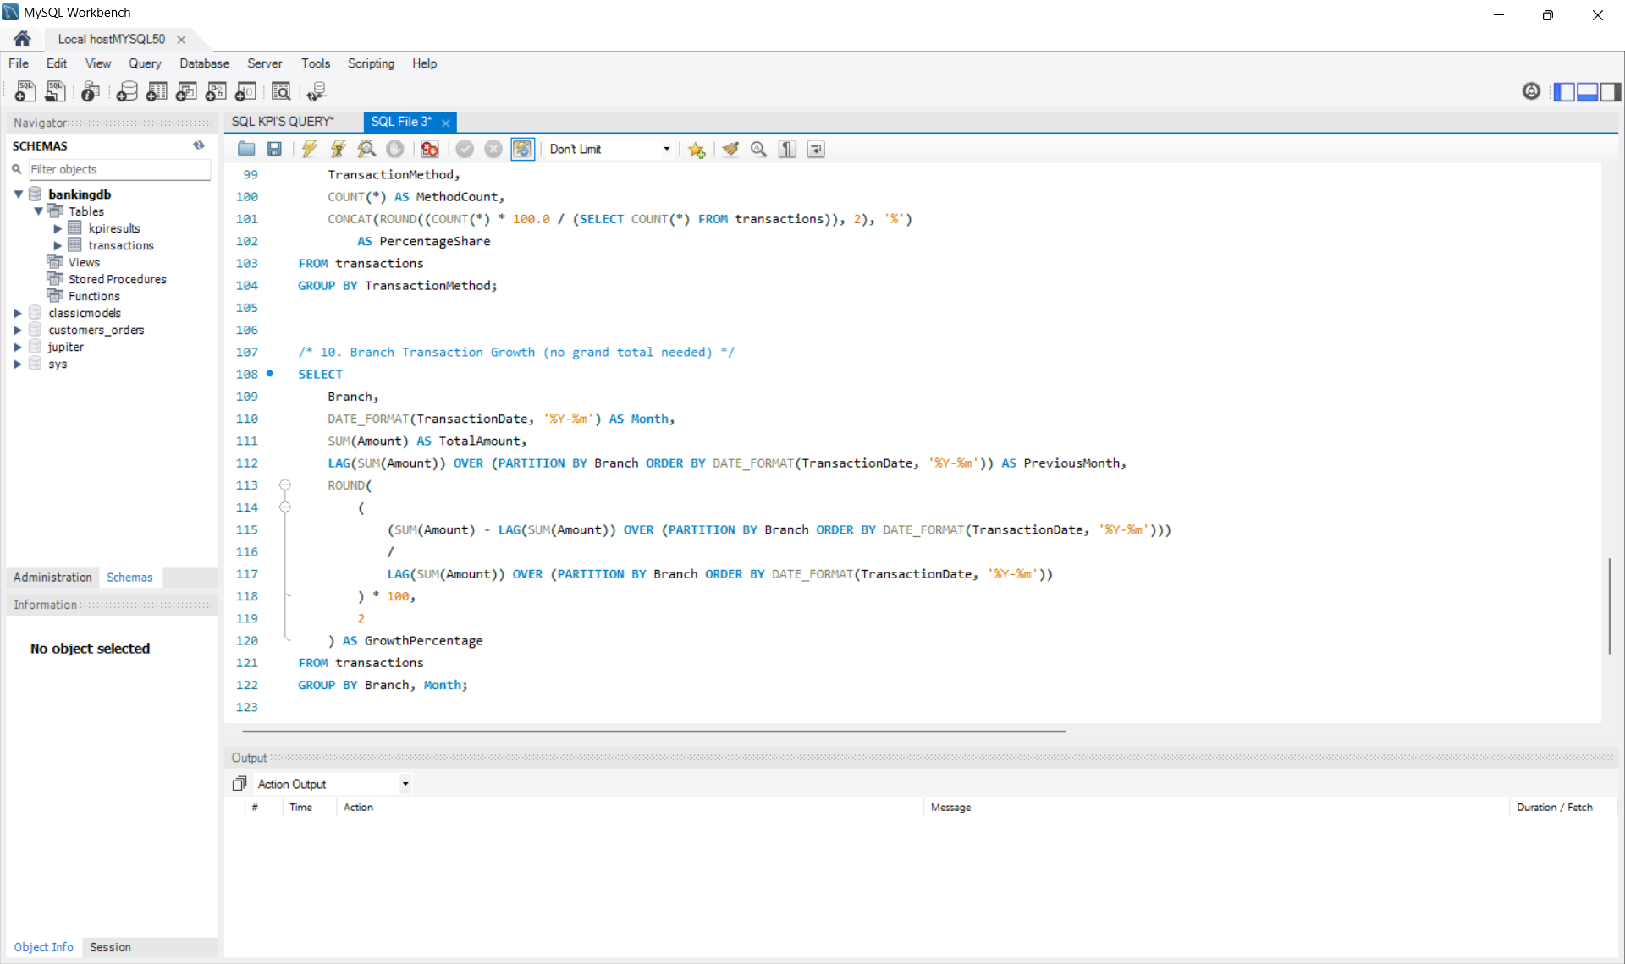
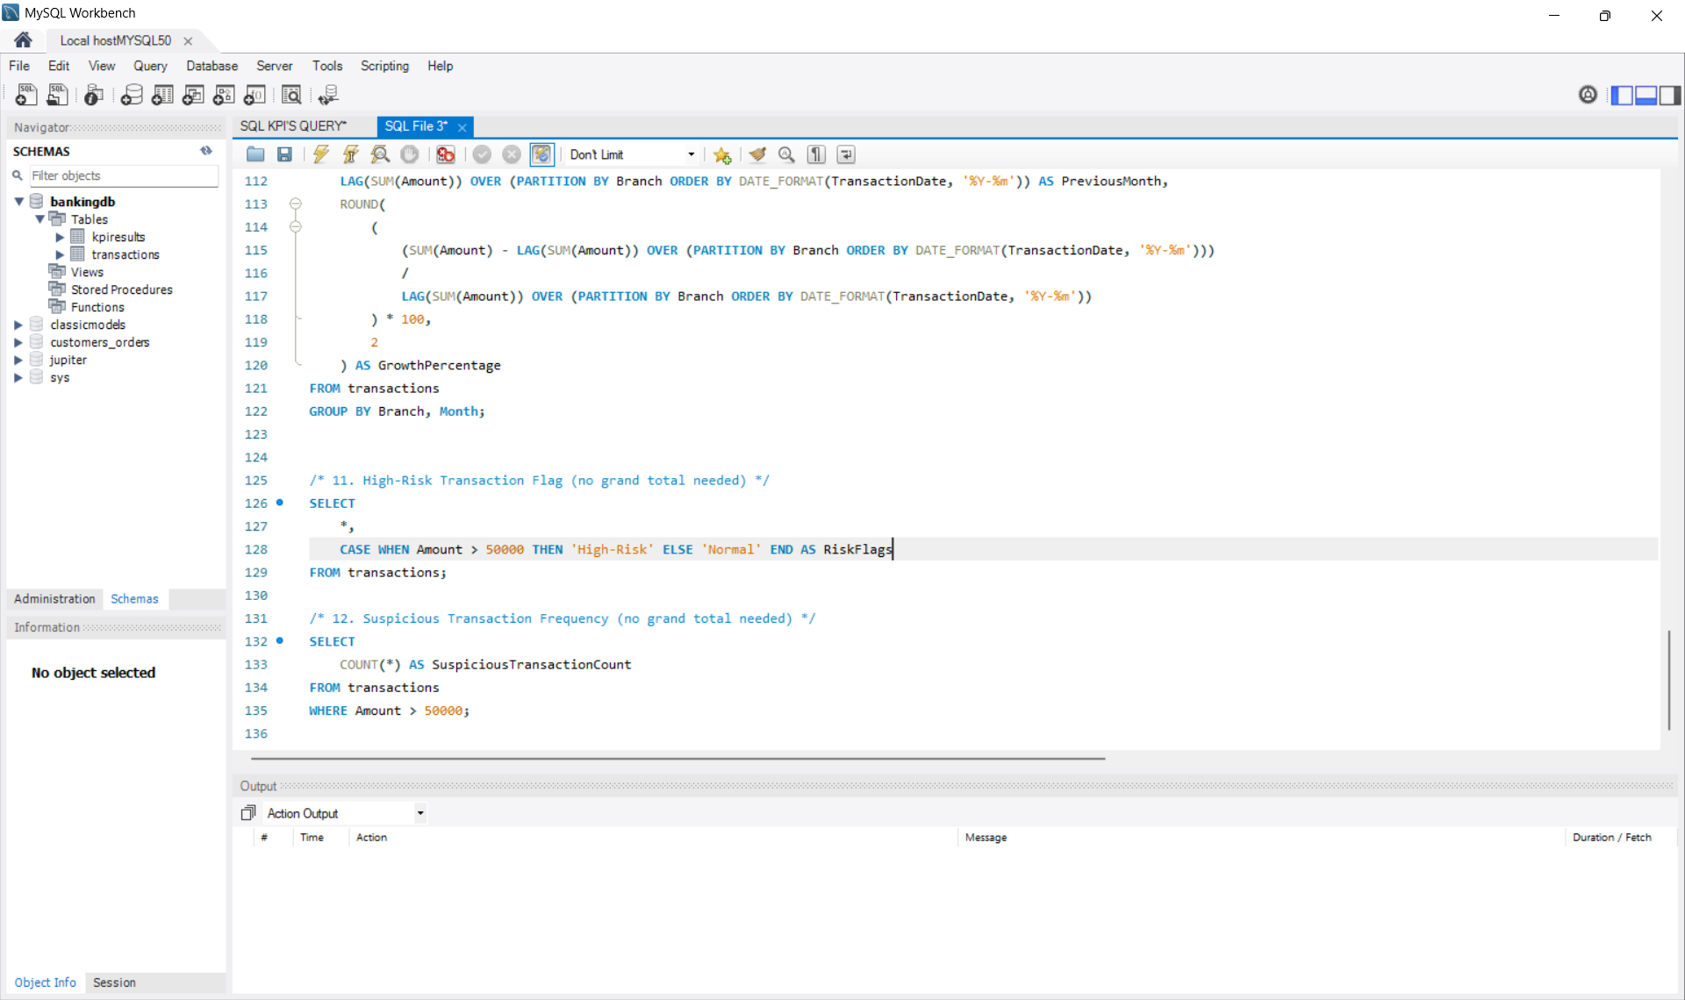
SQL Queries
SQL Queries
DBS Banking Analytics
14

Slide 16

Key Findings / Observations
Credit transactions are higher than debit transactions
Active clients contribute most of the loan amount
Personal loans dominate the portfolio
Branch performance varies month-to-month
High-risk transactions detected above ₹50,000
Suspicious transaction frequency helps fraud monitoring
DBS Banking Analytics
15

Slide 17
Challenges & Solutions
CHALLENGE
SOLUTION
Duplicate records
→
Removed using SQL cleaning
Null values
→
Replaced using Excel + SQL COALESCE
Dashboard alignment
→
Used Tableau containers + Power BI grid layout
KPI formatting
→
Applied custom number formatting (Millions, %, Ratios)
DBS Banking Analytics
16

Slide 18


Conclusion
Built complete banking analytics dashboards using Excel-PIVOT, SQL, Power BI, and Tableau
Implemented 24 KPIs across Loan, Customer, Branch, and Transaction domains
Strengthened skills in SQL, data modeling, dashboard design, and fraud detection
Gained real-time project experience in end-to-end analytics workflow
Thank You
DBS Banking Analytics
17

